Slide 1


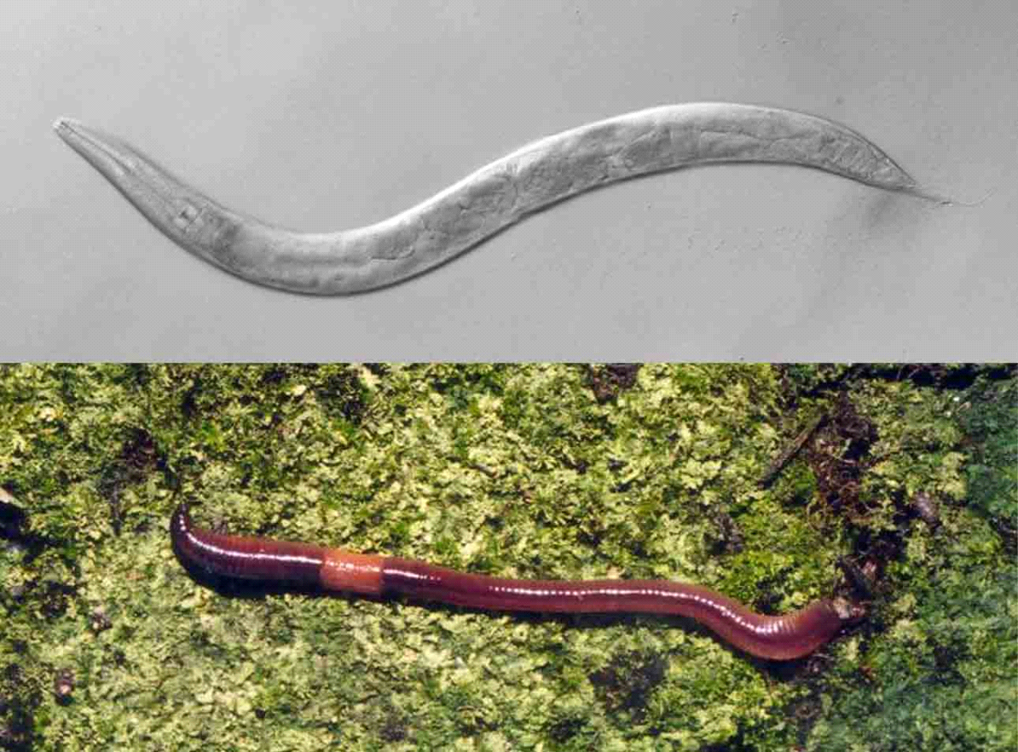
Rapid Exploration of Novel Organism Omics ~RENOO~
Oliver Rimington
Supervised by: Prof. Peter Kille
Department of Biosciences
Cardiff University

Slide 2
'Target Audience'
Working with a new model organism
Using Omic scale data generation
An interest in core biology of that organism
TF binding
Methylome
Genomics
DNA
Footprinting
/Ch-IP
miRNAs
Transcriptome

Slide 3
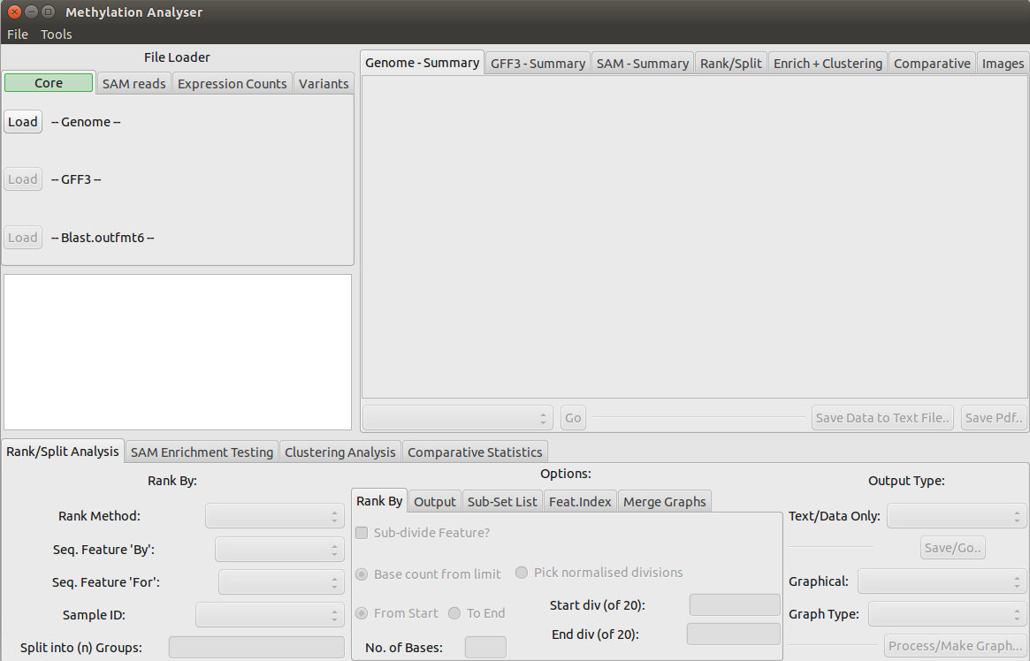
Presenting...
R.E.N.O.O

Slide 4
Core Idea
Genome
Set of qualitative annotations
Coerced
Into
Singular
Framework
Short Read alignments
Polymorphisms
Gene Expression OR any arbitrary Annotation-Bound Quantitation
A 8.2 2 9 4
B 4 3 8 21
C 7 4 86 9
D 4 8 6.1 7
…
…
A 8.2 2 9 4
B 4 3 8 21
C 7 4 86 9
D 4 8 6.1 7
…
…
A 8.2 2 9 4
B 4 3 8 21
C 7 4 86 9
D 4 8 6.1 7
…
…

Slide 5
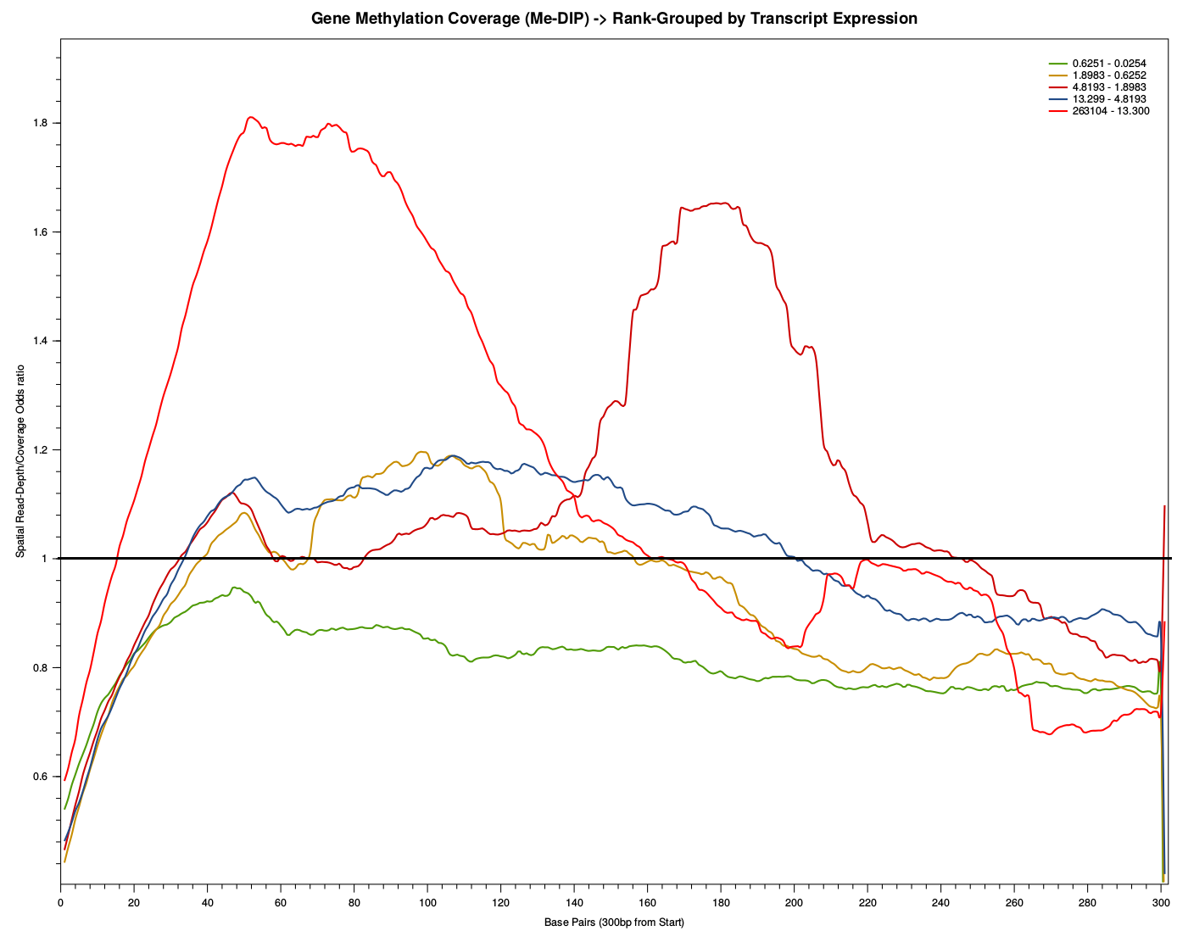
Core Idea
In…
Genome
For:
Annotation type X
Select:
A 8.2 2 9 4
B 4 3 8 21
C 7 4 86 9
D 4 8 6.1 7
Information Track A
Information Track B
Discover Structure of Co-occurrence!

Slide 6
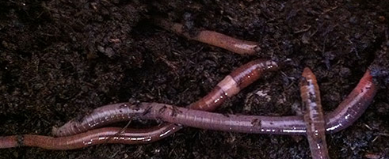
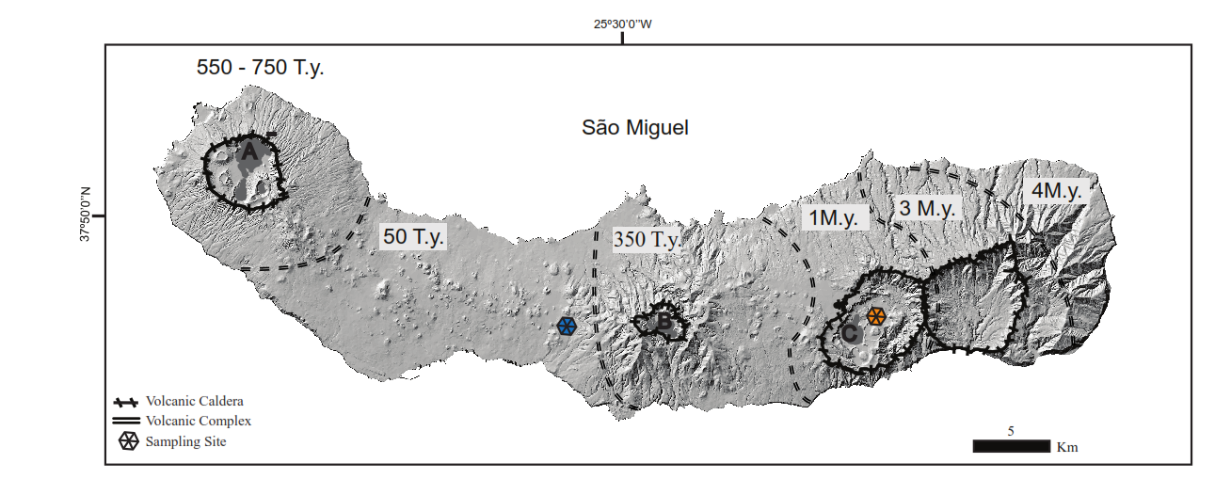
Exploring a Dataset
Inactive-Volcanic Site
Active Volcanic Site
Reciprocal Transplantation of
Amynthas gracilis
Transcriptome
Genome Assembly
miRNAs
Methylome

Slide 7
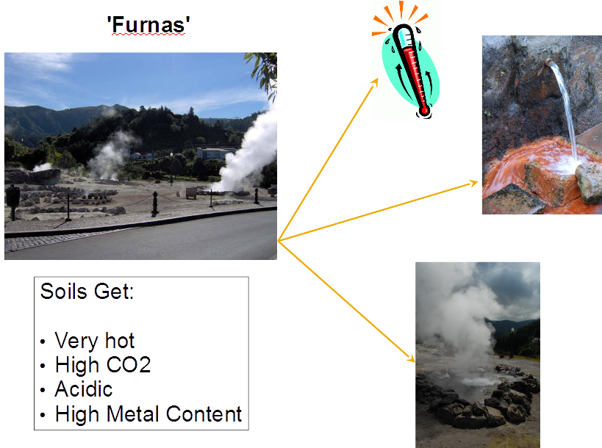

Slide 8
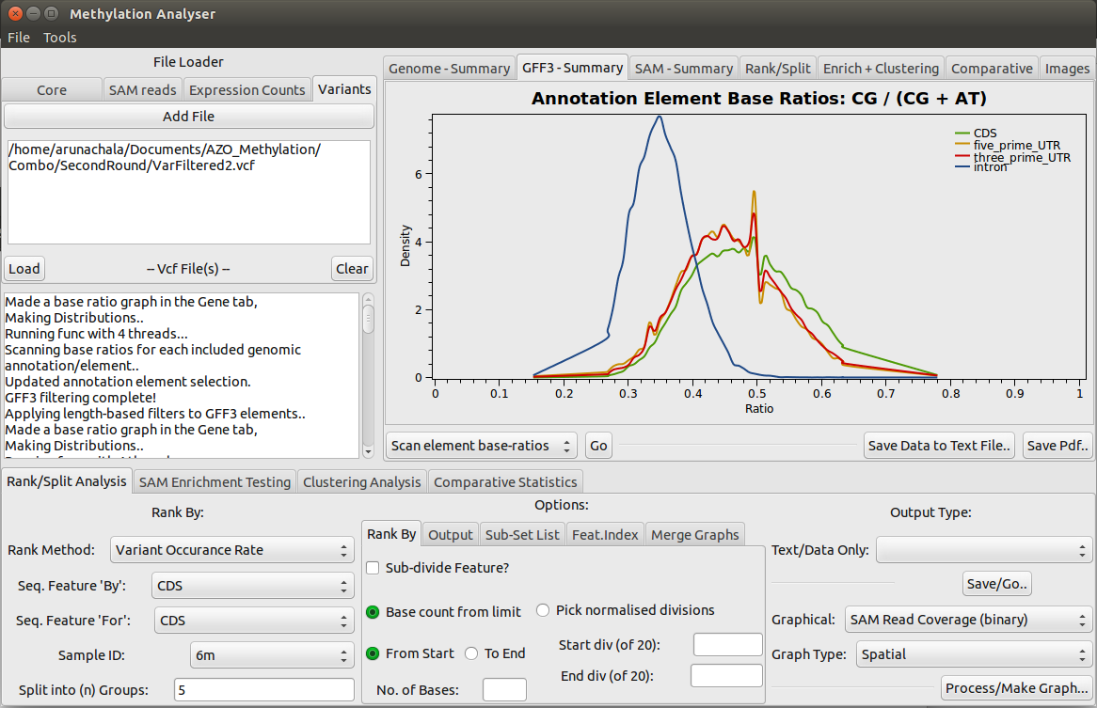
Data Input Tabs
Graphical Output Viewing Tabs
Analysis Modules
Quick Summaries + Output TSV / PDF

Slide 9
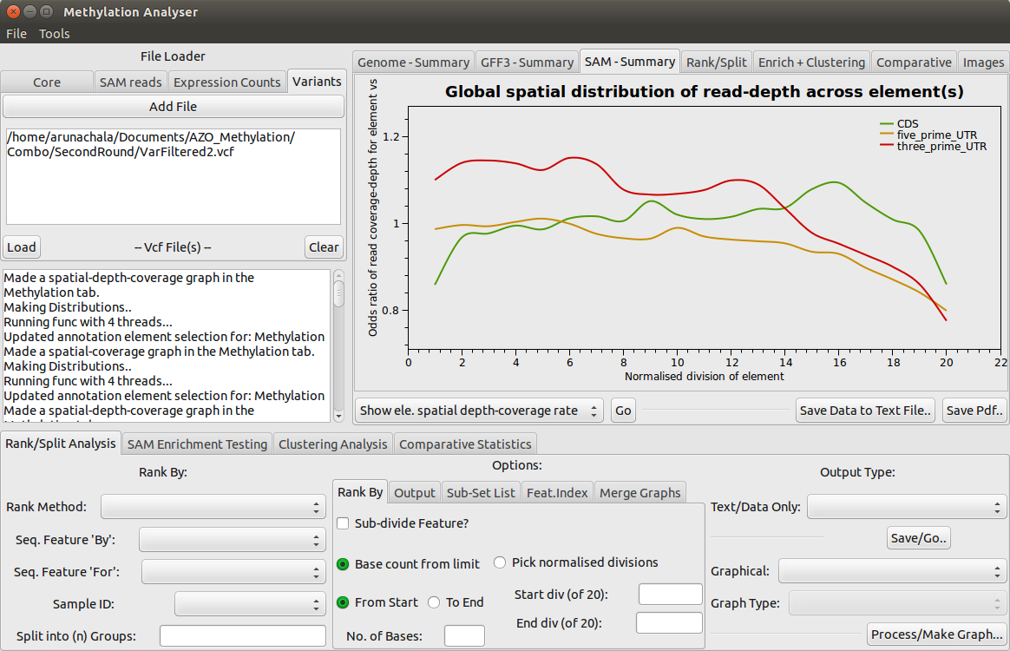
Methylation vs Gene Features

Slide 10
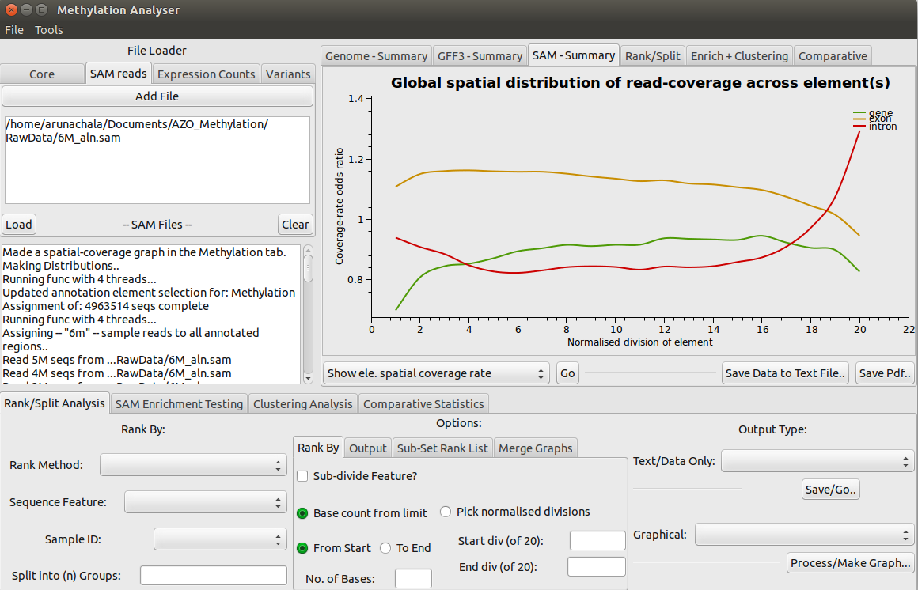
Methylation vs Gene Features

Slide 11
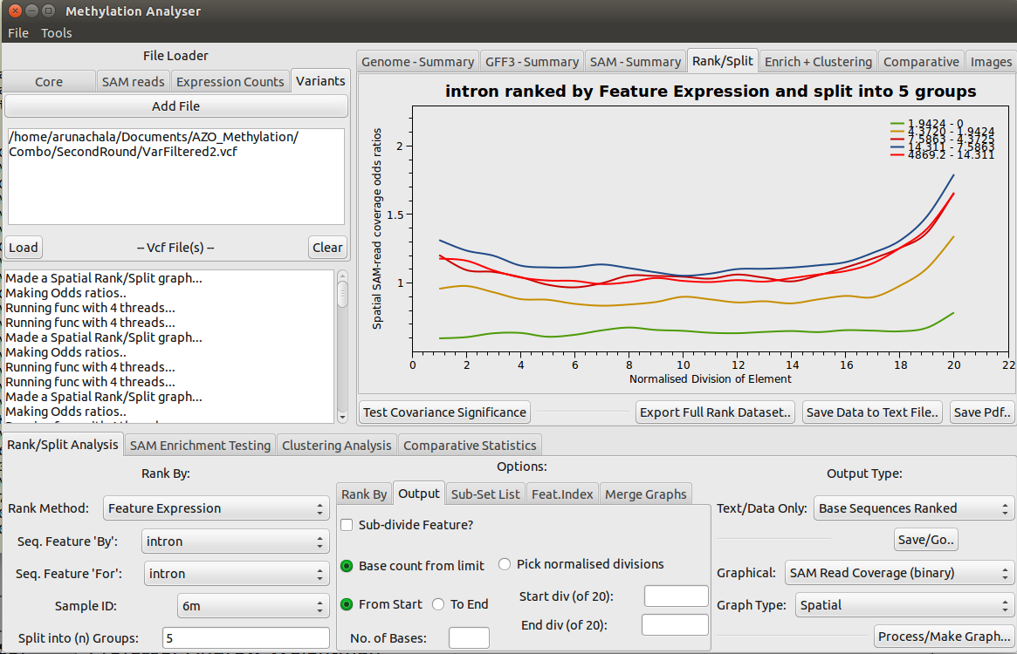
Investigating Introns Further..

Slide 12
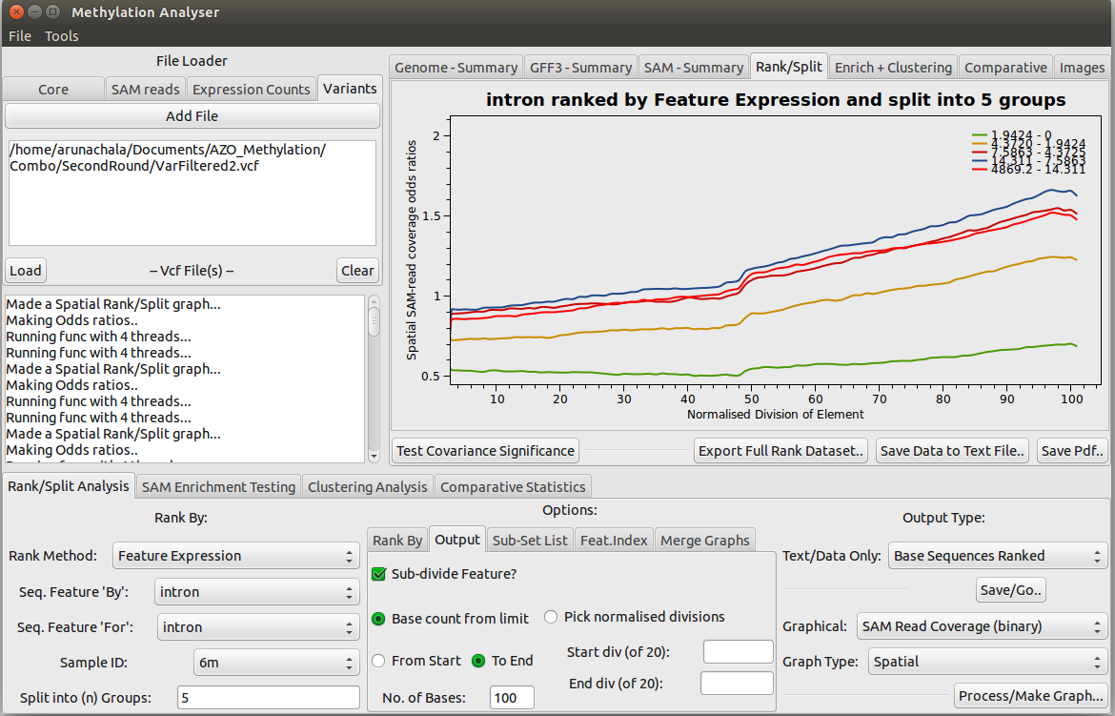
Investigating Introns Further..

Slide 13
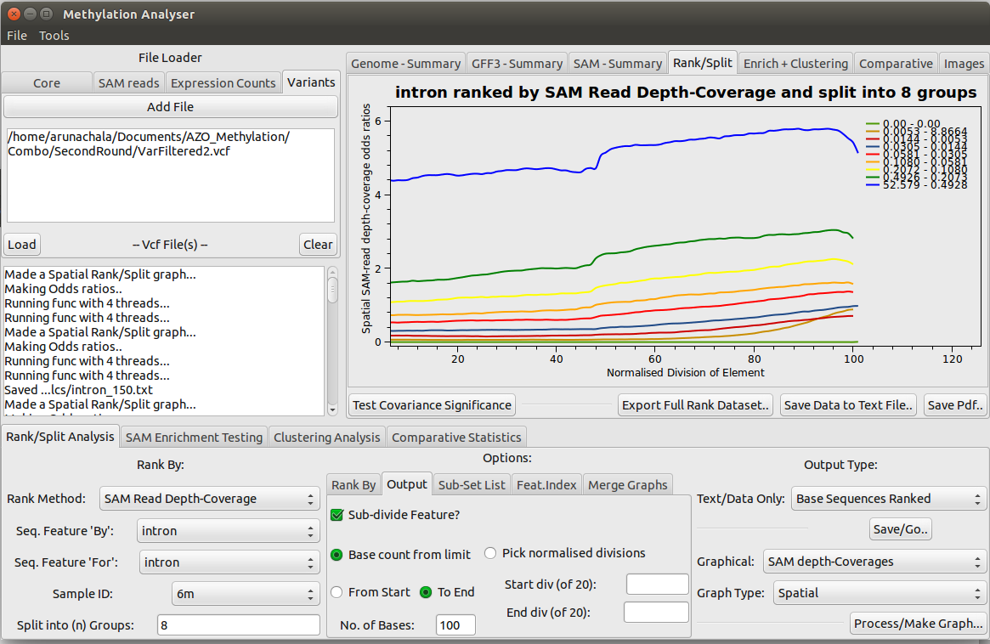
Investigating Introns Further..

Slide 14
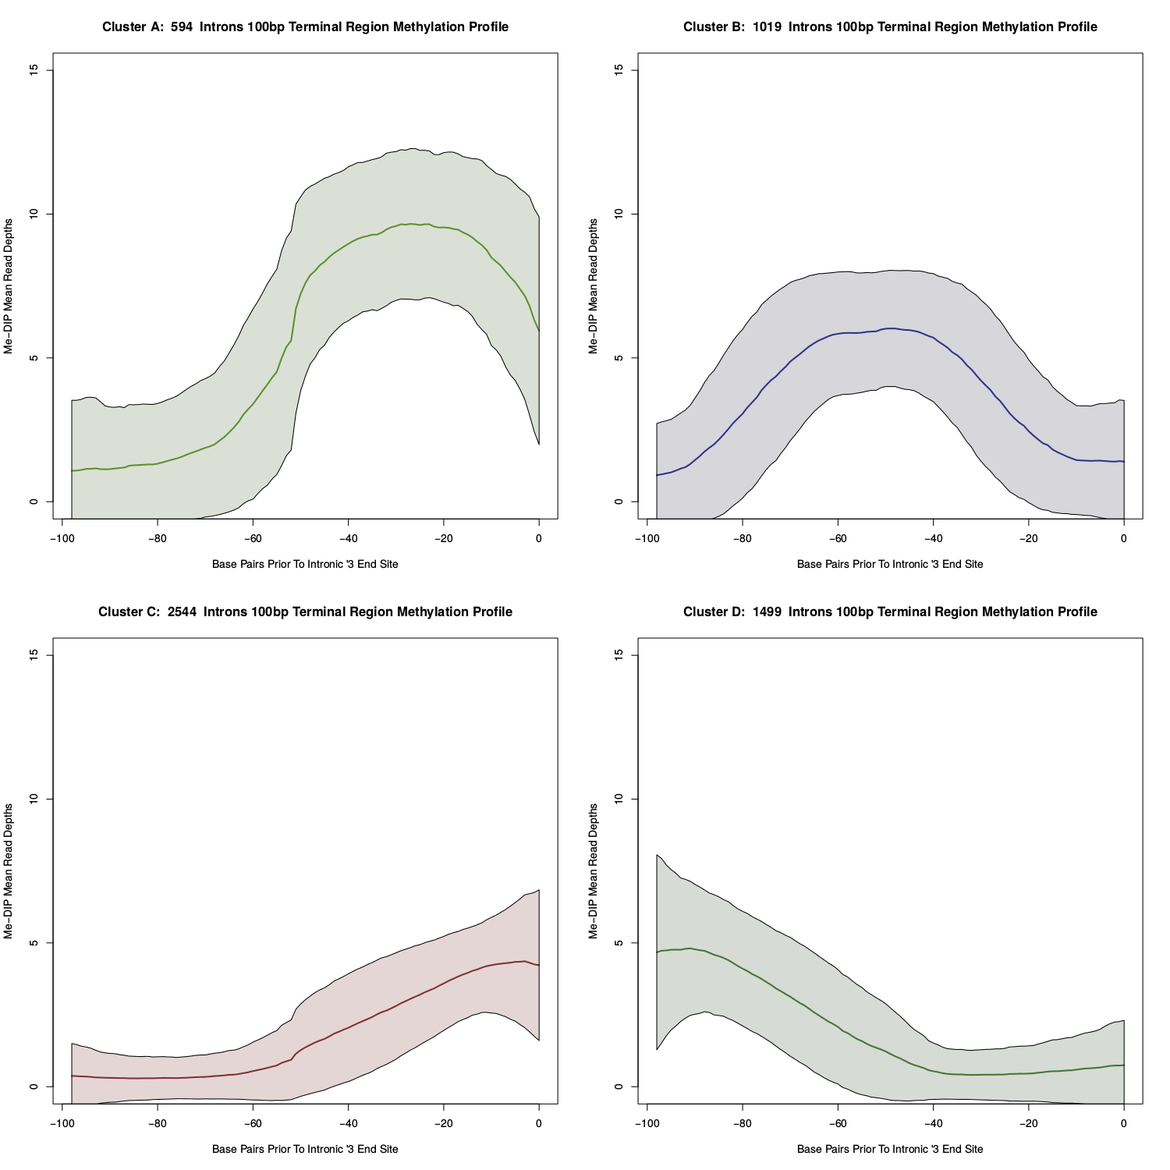
Working Outside the Software Clustering Intronic 3 Prime Methylation Patterns
594 Introns

Slide 15
Methylation vs Expression Level

Slide 16
Methylation vs Expression Level
20% Highest Gene Expression
20% Closest to Median
Gene Expression
Transcription Start Site
300bp In

Slide 17
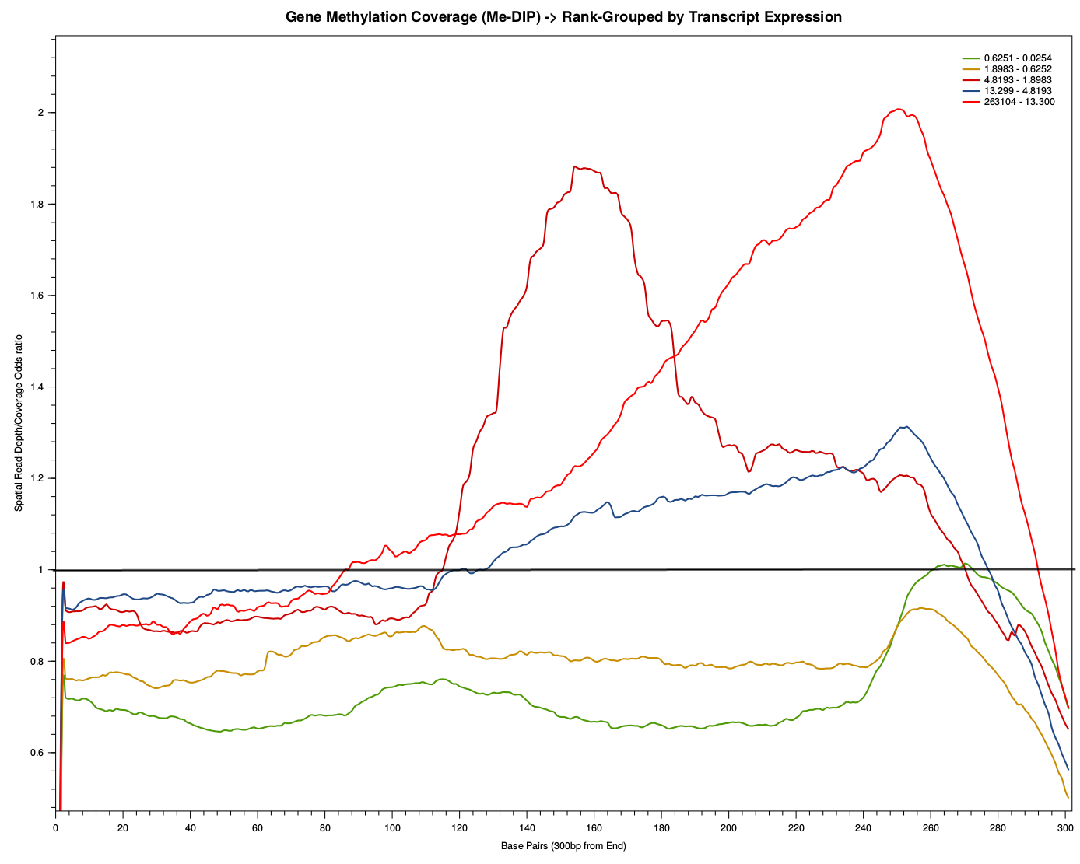
Methylation vs Expression Level
20% Highest Gene Expression
20% Closest to Median
Gene Expression
-300bp
Transcription End Site

Slide 18
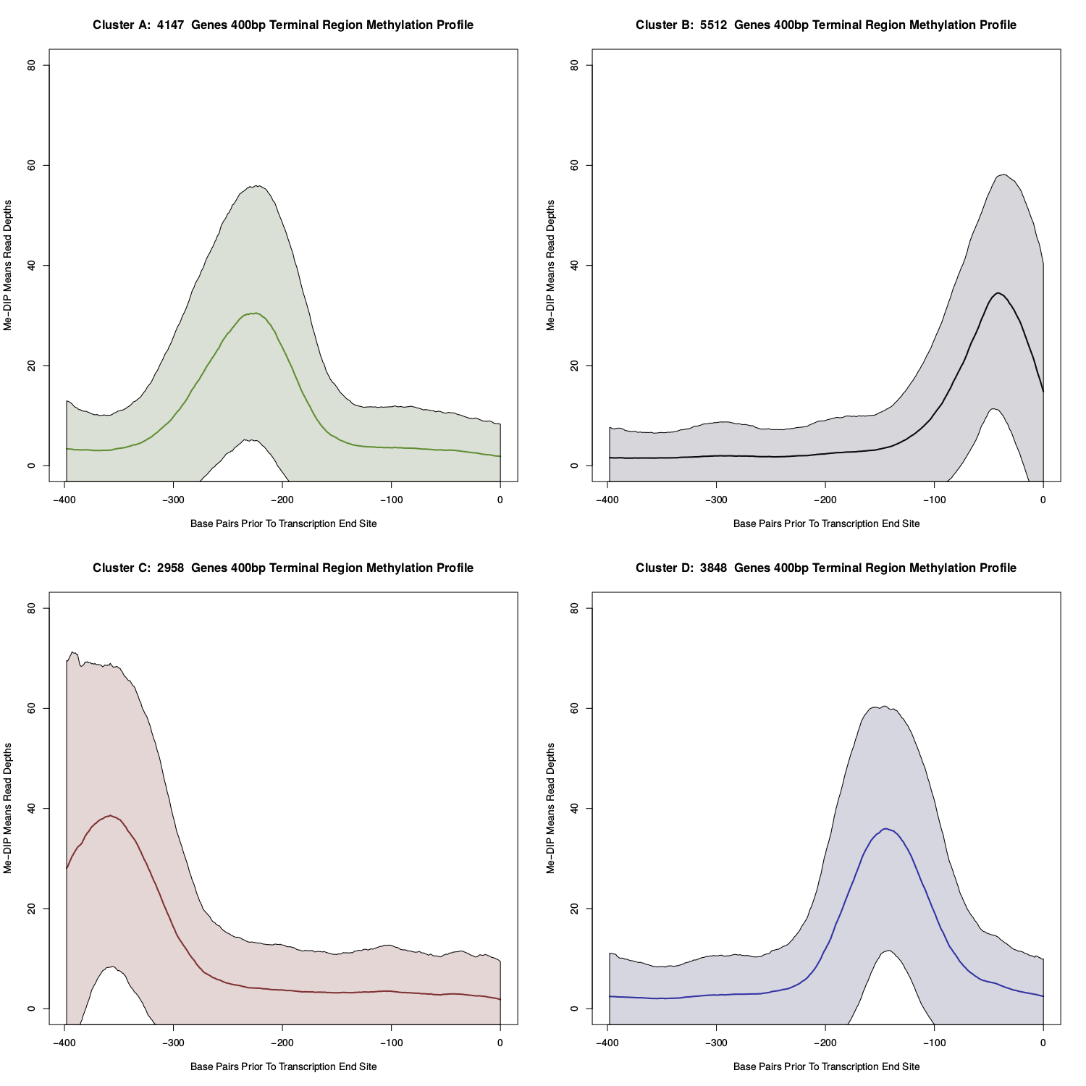
3'Prime Transcribed Region: Methylation Pattern Clusters Shows ~100bp Distinct Regions

Slide 19
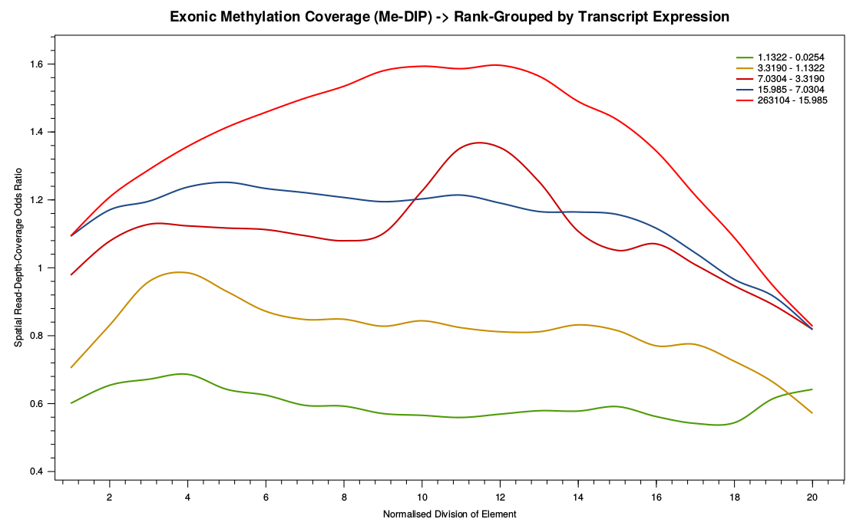
Methylation vs Expression Level

Slide 20
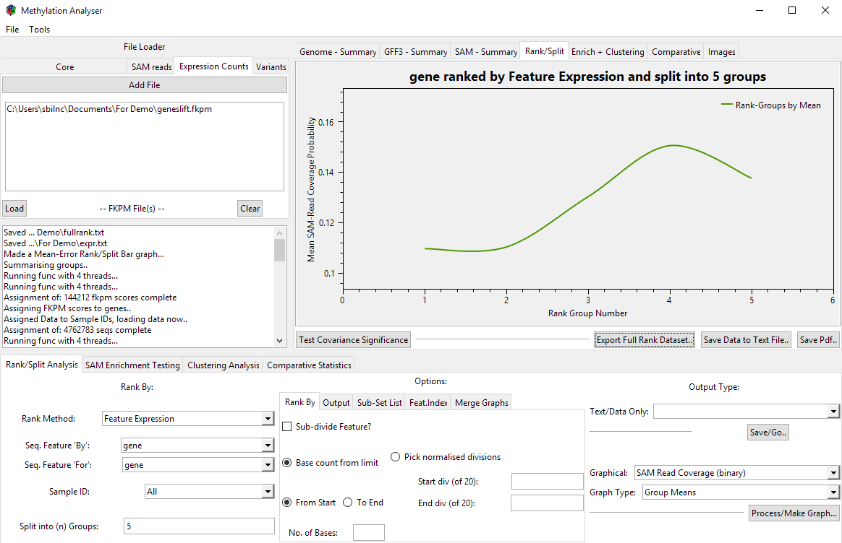
Methylation vs Expression Level

Slide 21
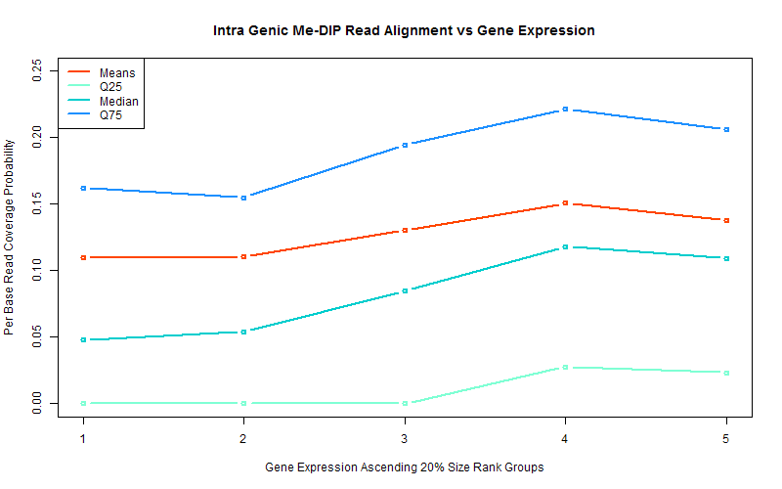
Methylation vs Expression Level

Slide 22
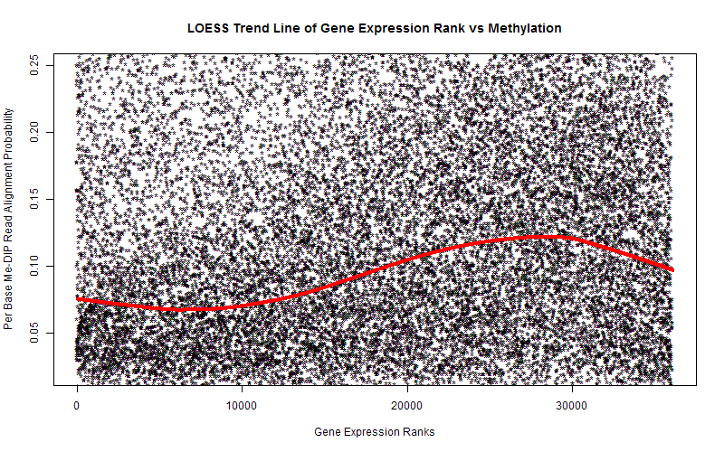
Methylation vs Expression Level
What about these Genes?
Or these ones??

Slide 23
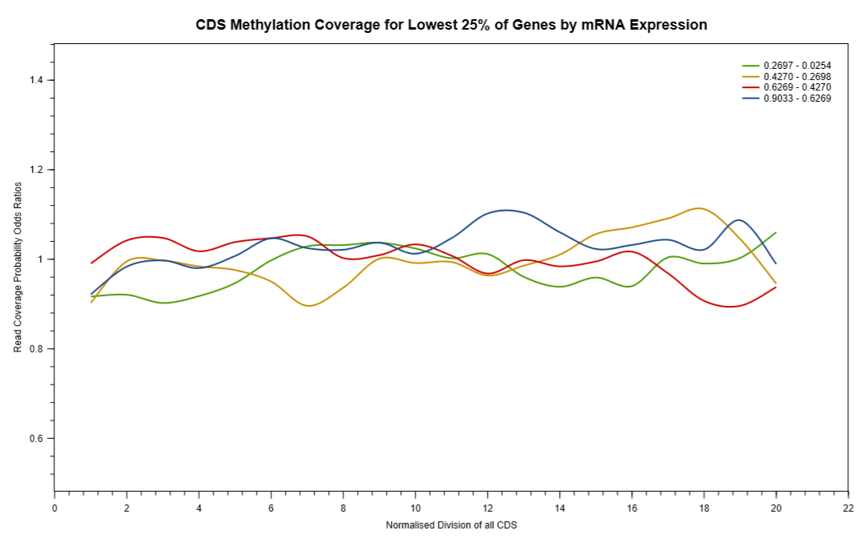
Methylation vs Expression Level
?

Slide 24
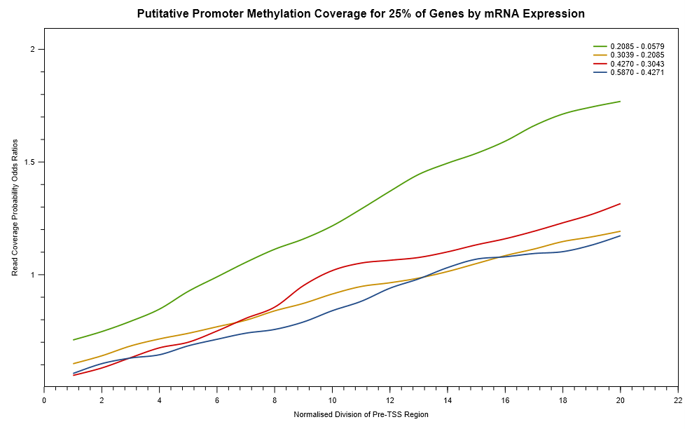
Methylation vs Expression Level
-34bp to TSS
Transcription
Start Site

Slide 25
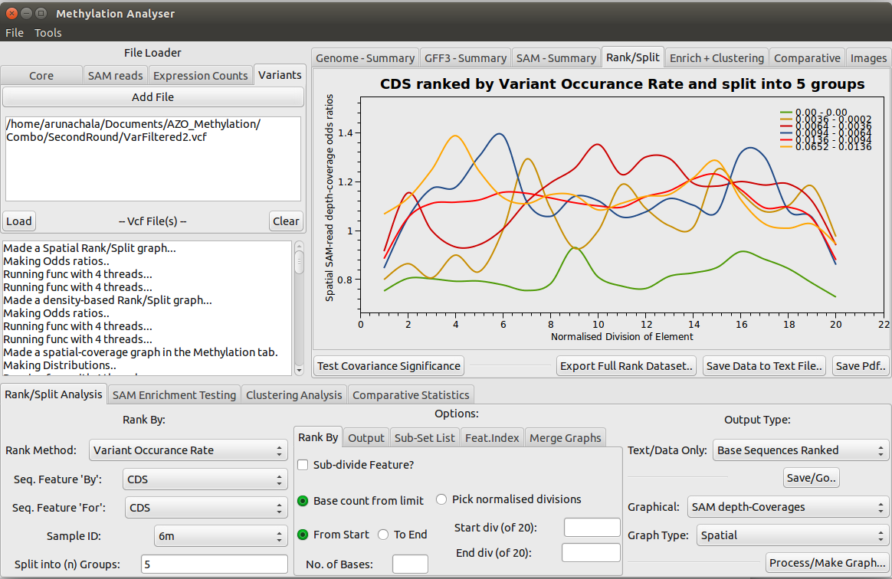
Methylation vs Variant Incidence Rate.. A Mess!

Slide 26
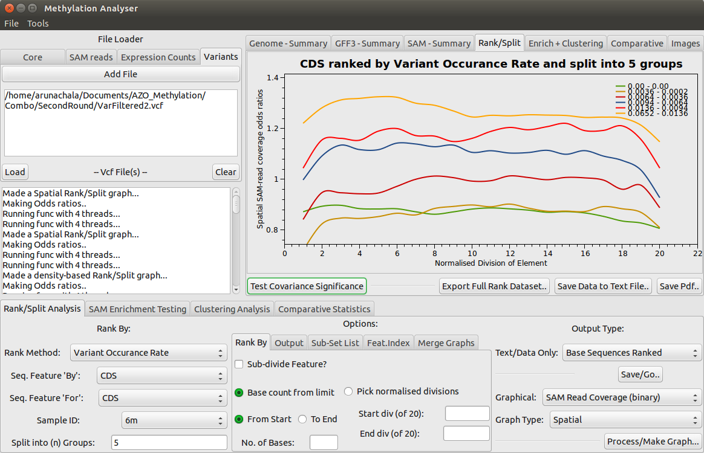
...Or is it??

Slide 27
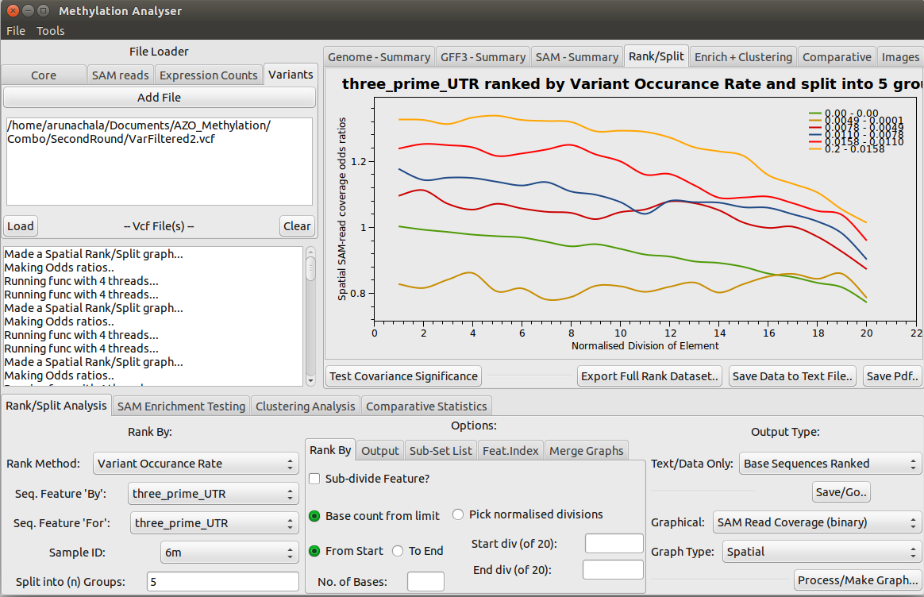
Methylation vs Variant Incidence in 3'UTR

Slide 28
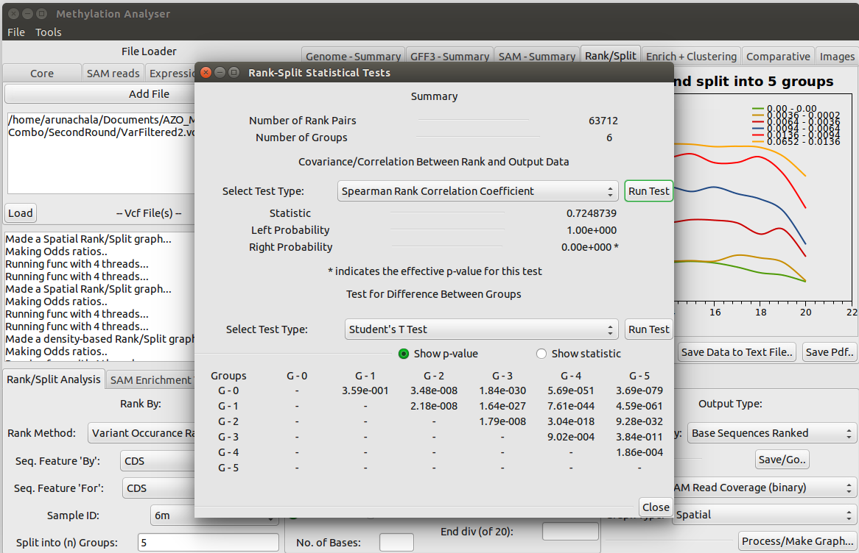
Plug-In Quick Stats

Slide 29
MiRNA Putative Target Sites..
MiRNA Binding sites were generated
RENOO treats binding site indexes in same way as read alignments
The same statistical processes can be applied!
Looking at an overview…

Slide 30
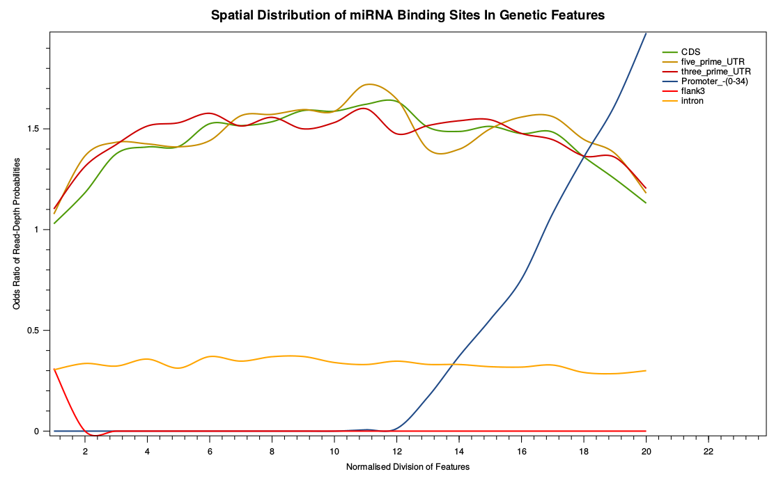
miRNA Putative Target Sites vs Genes

Slide 31
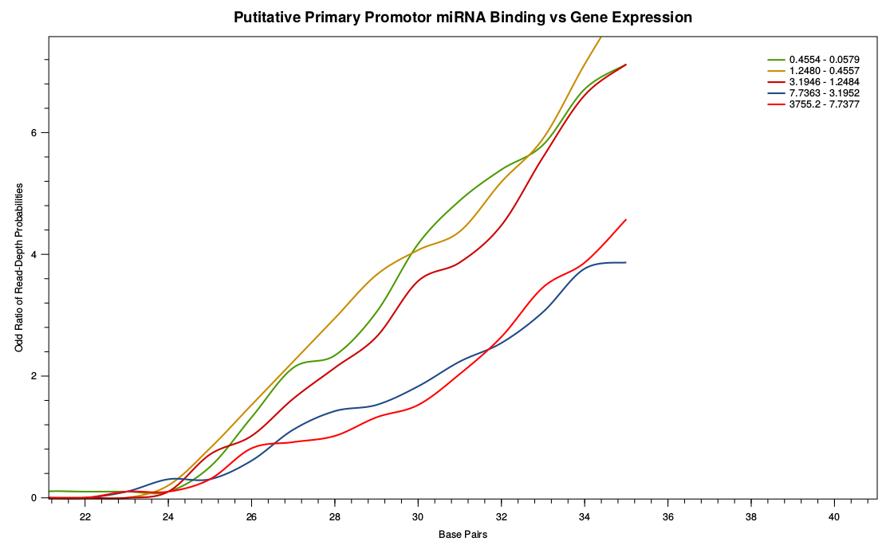
miRNA Putative Binding Sites vs Promoters
Transcription
Start Site

Slide 32
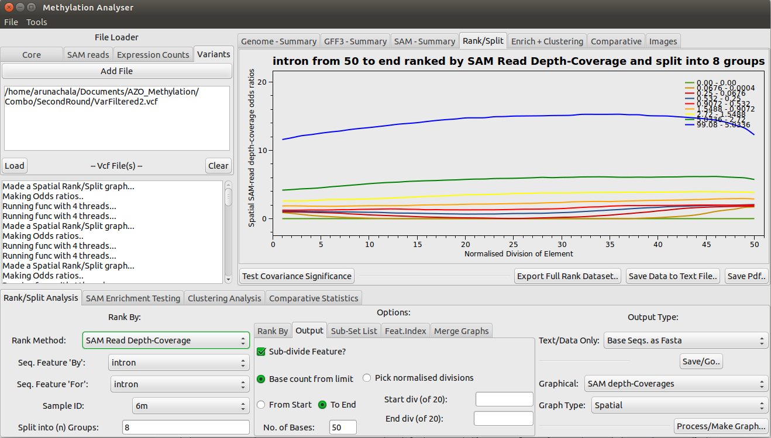
Dynamic Fasta Output

Slide 33
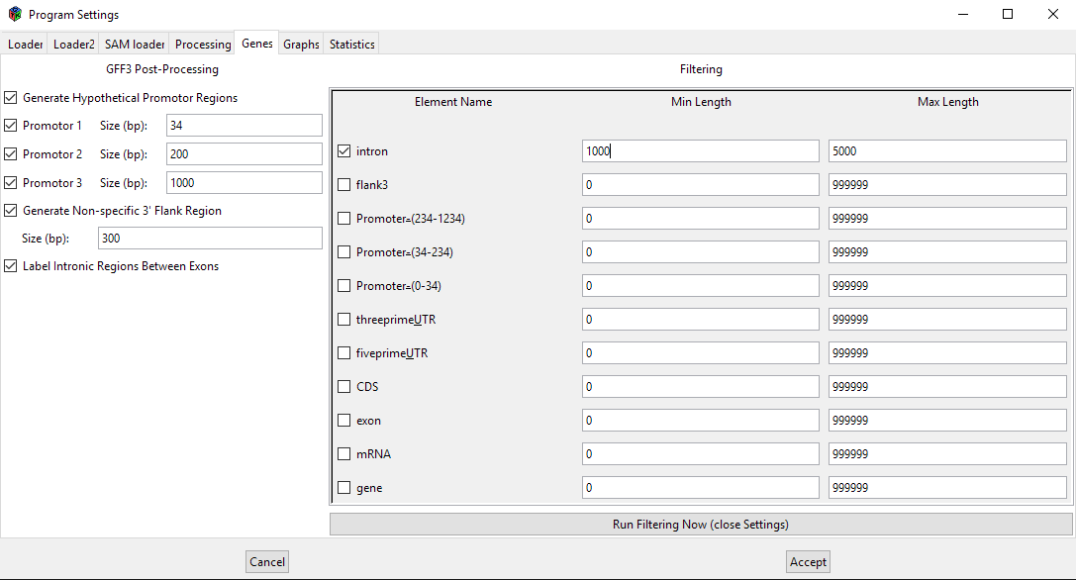
Annotation Size Selection

Slide 34



Acknowledgements
Prof. Pete Kille
For being a good supervisor!
Dr Luis Cunha
For gathering the samples and data used in this demonstration (and designing those experiments).
MonoDevelop IDE
For enabling easy cross-platform development!

Slide 35


